Slide 1
Questions and Answers
Questions and Answers

Slide 2
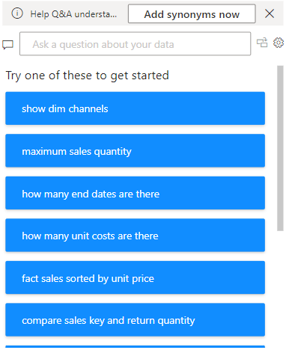
Questions and Answers
Add synonyms now
Note: This lab is based on the Excel file Sales.xlsx in the Excel sources
Purpose : Allows users to improve Q&A performance by adding synonyms for field names or terms.
Why it's useful : If users use different terms to refer to the same field (for example, "revenue" instead of "sales"), you can add these synonyms so Power BI understands the query.
Example : Add synonyms such as "profit" for "net income" or "regions" for "territories."
Add a question and answer visual to the scene
Suggested questions
Purpose : Power BI generates a list of predefined questions based on the structure and metadata of the dataset.
Why it's useful :
Gives users ideas on the types of questions they can ask.
Encourages exploration of the data set to learn from it.
Examples in the screenshot :
"Show dark channels": Probably returns an array of channel dimensions.
“Maximum Sales Quantity”: Returns the highest sales quantity in the dataset.
Search box
Purpose : Allows users to enter a natural language question about their dataset.
Example : You can enter "What is the total sales?" or "Show sales by region."
Power BI uses its AI capabilities to interpret the question and generate a visual (e.g., a chart, graph, or KPI) based on the dataset.

Slide 3
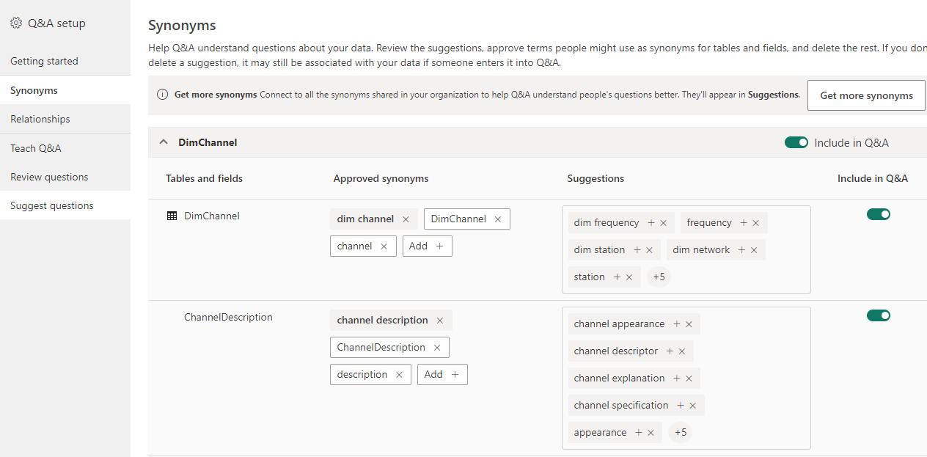
Questions and Answers
Adding synonyms now leads to this configuration page to add as a
natural human language to create more flexible expressions when writing questions

Slide 4
Questions and Answers
Adding synonyms now leads to this configuration page to add as
natural human language to create more flexible expressions when writing questions
To display the global configuration dialog box
To convert the question into a visual

Slide 5
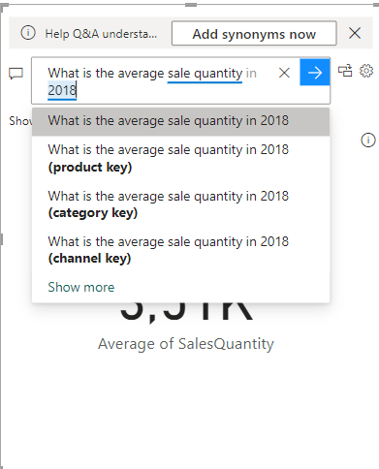
Questions and Answers
Here is an example of using Q and A

Slide 6
Thank you
Thank you

